Slide 1
JNeural
Julio Grillo
CISC 190

Slide 2
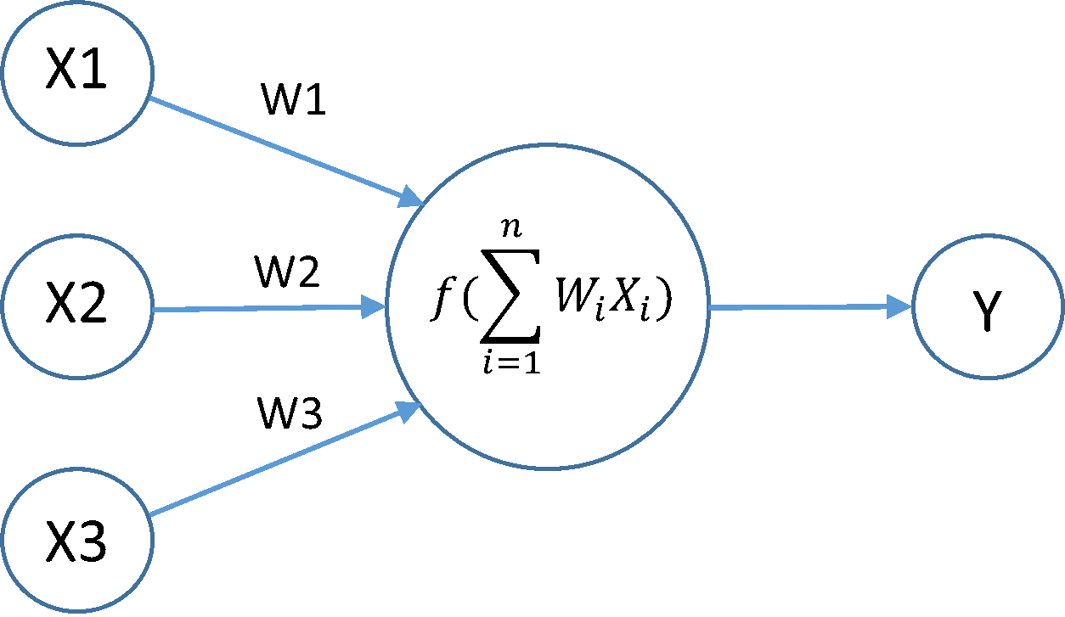
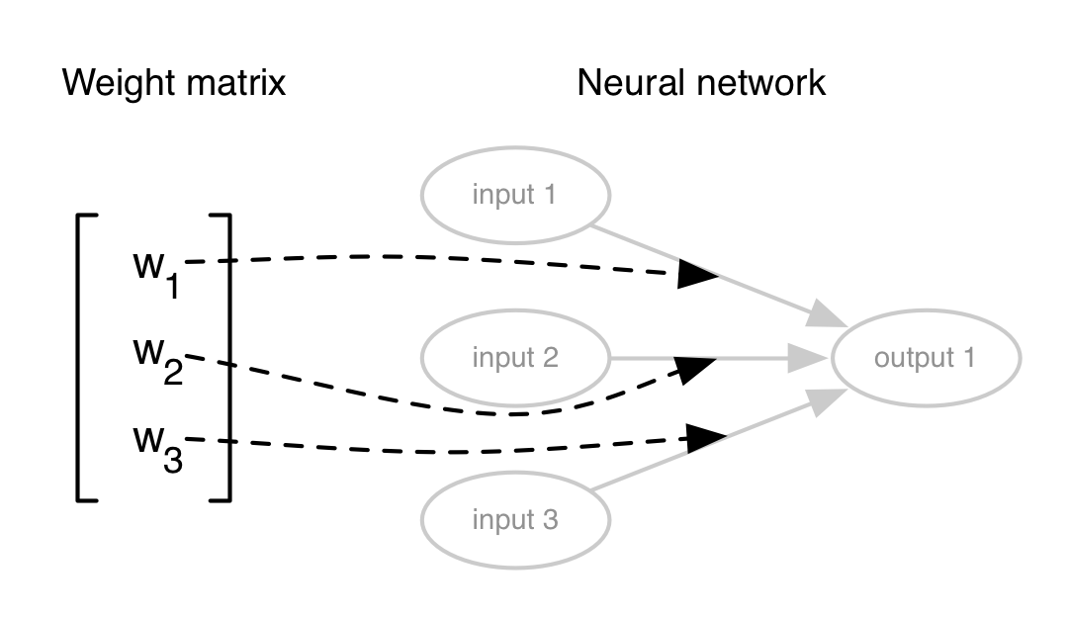
Neural Network
http://stackoverflow.com/questions/40537503/deep-neural-networks-precision-for-image-recognition-float-or-double
http://stackoverflow.com/questions/22853751/graphical-representation-of-deep-learning-network

Slide 3
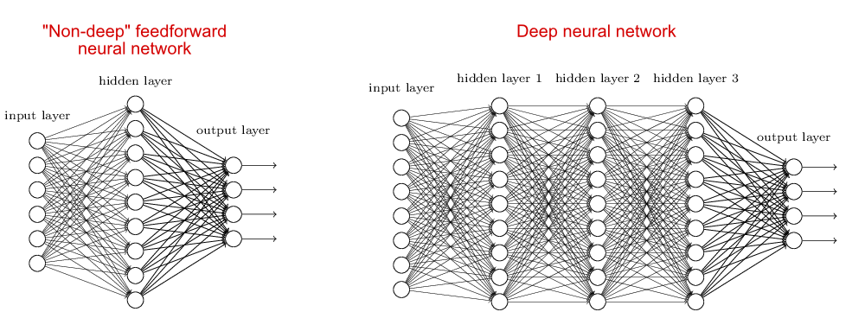
Neural Network
https://stats.stackexchange.com/questions/182734/what-is-the-difference-between-a-neural-network-and-a-deep-neural-network

Slide 4
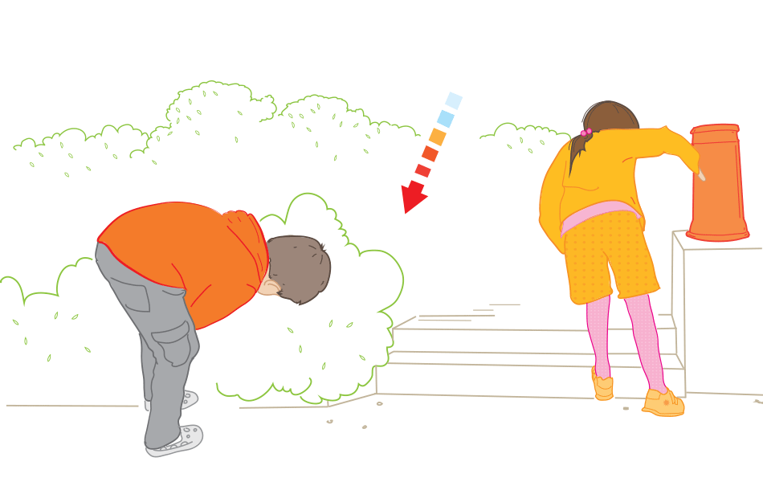
Hot or Cold
http://www.safefood.eu/Childhood-Obesity/Your-Tools/Bring-Back-Play/Hot-and-Cold.aspx

